Slide 1
Installing Jupyter Notebook on
Windows7 x64
Linux – Ubuntu/Mate
Hamilton Python Users Group
Ian Stewart
14-May-2018.
Slide Show is intended as a reference document:
https://github.com/HamPUG/meetings/tree/master/2018/2018-05-14

Slide 2
Jupyter Notebook
A web-browser interface for writing python code.

Slide 3
Jupyter Notebook
Formerly IPython Notebook.
Jupyter Notebook provides the web-based client, while IPython remains as the server engine.
Home page: http://jupyter.org/
Use cmd window to check pip is at latest version:
> pip3 install --upgrade pip

Slide 4
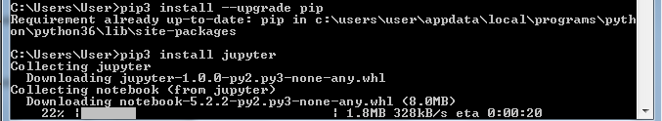
Jupyter Notebook
Install Jupyter (and IPython)
> pip3 install jupyter

Slide 5
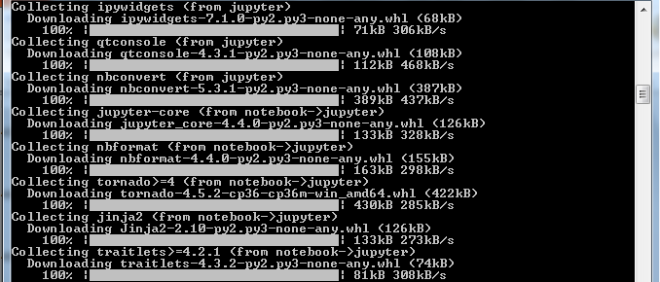
Jupyter Notebook
Install Jupyter (and IPython) continues…

Slide 6
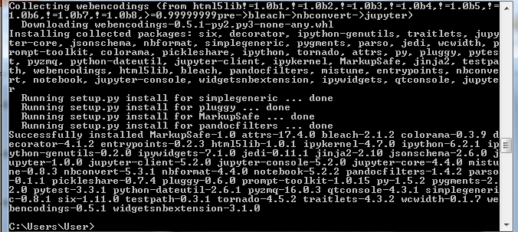
Jupyter Notebook
Install Jupyter (and IPython) completes…

Slide 7
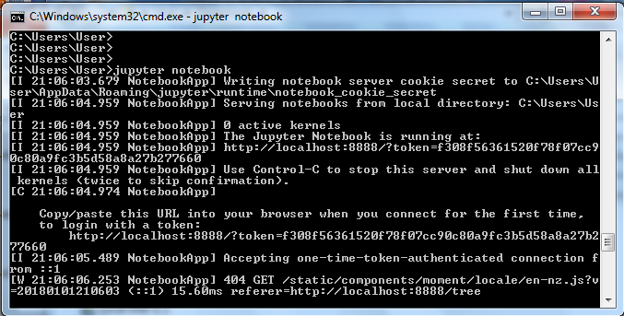
Jupyter Notebook
Launching Jupyter Notebook from cmd window…
> jupyter notebook

Slide 8
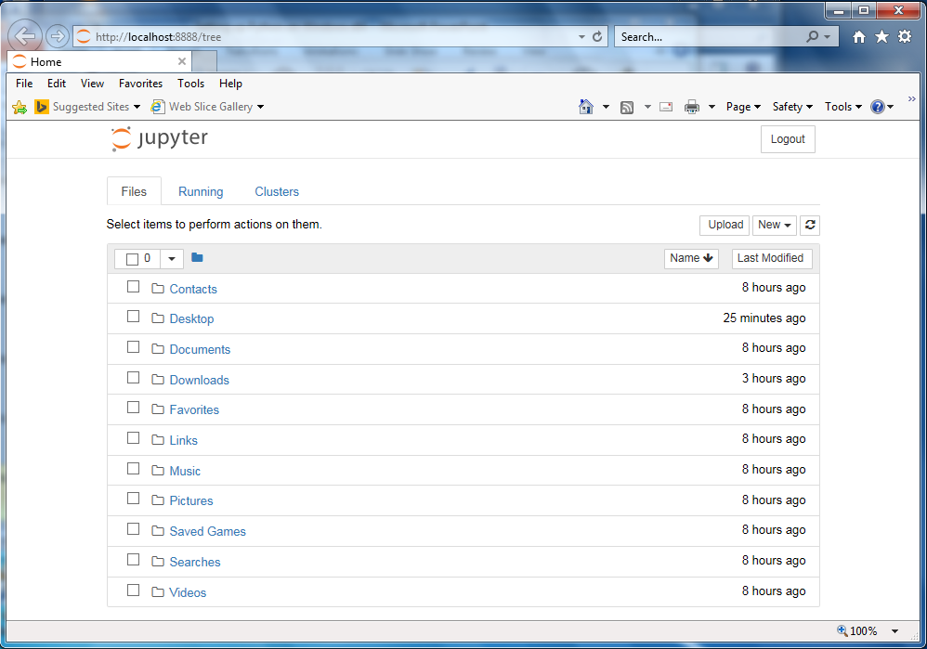
Jupyter Notebook
Jupyter client displays in web-browser

Slide 9
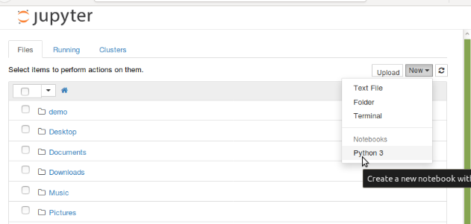
Jupyter Notebook
Click: New and Python3
To create new jupyter notebook

Slide 10
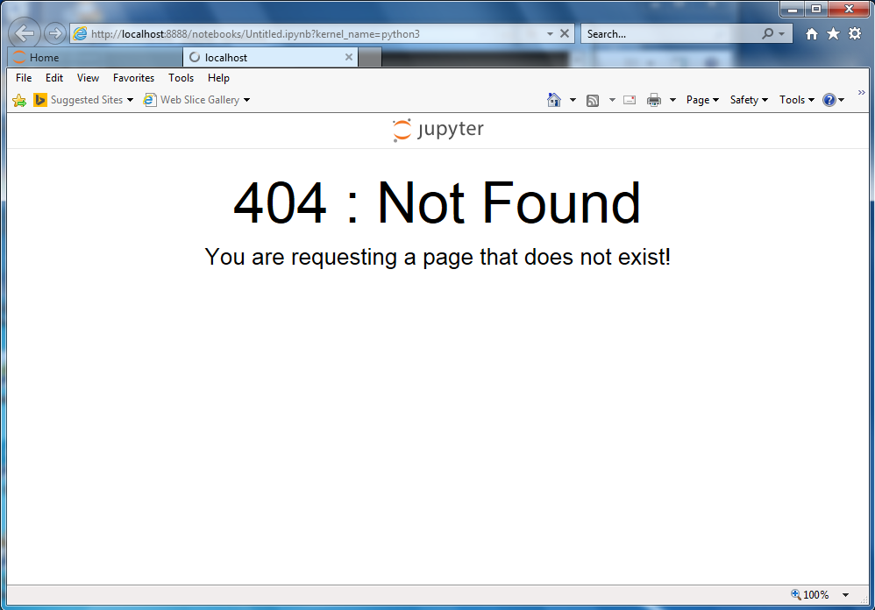
Jupyter Notebook
Glitch. Don’t Panic!…
Click:Home tab then Click: localhost tab…

Slide 11
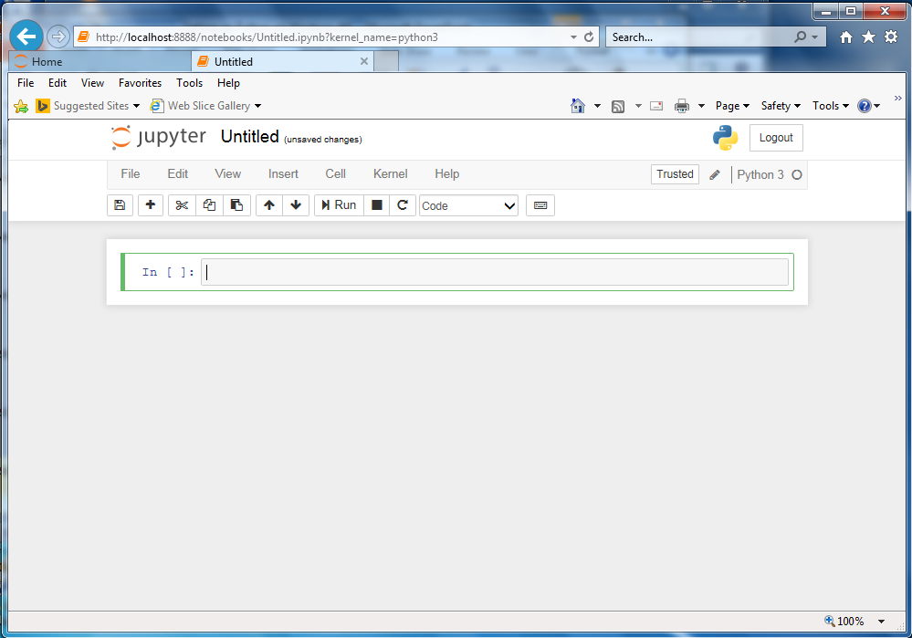
Jupyter Notebook
Jupyter client for the file named Untitled.ipynb…

Slide 12
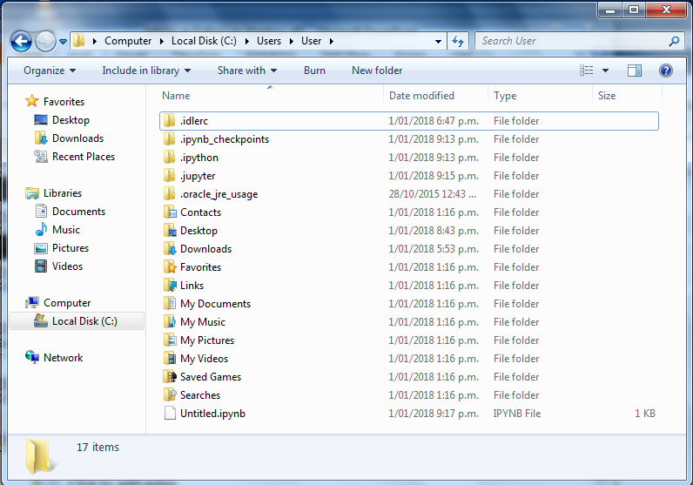
Jupyter Notebook
Untitled.ipynb file now exists…

Slide 13
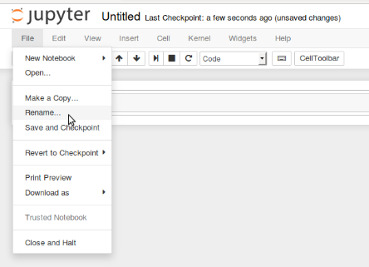
Jupyter Notebook
Click File and then click on Rename…

Slide 14
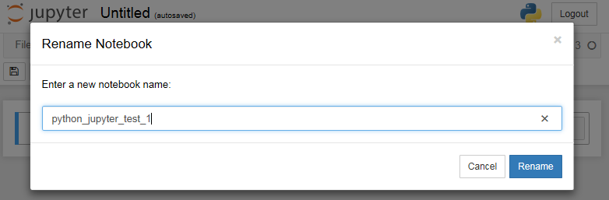
Jupyter Notebook
Rename the file…

Slide 15
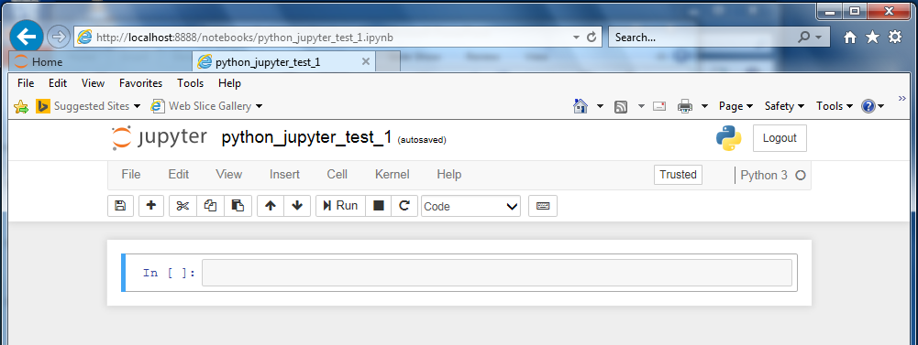
Jupyter Notebook
Jupyter now with the renamed file…
File manager now shows the file renamed…

Slide 16
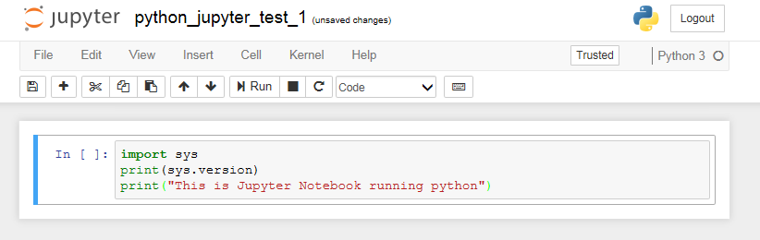
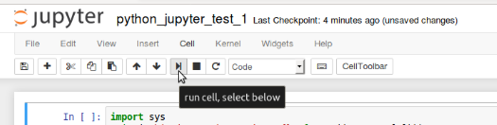
Jupyter Notebook
Write python code in a cell…
Click: Run icon to execute the code…

Slide 17
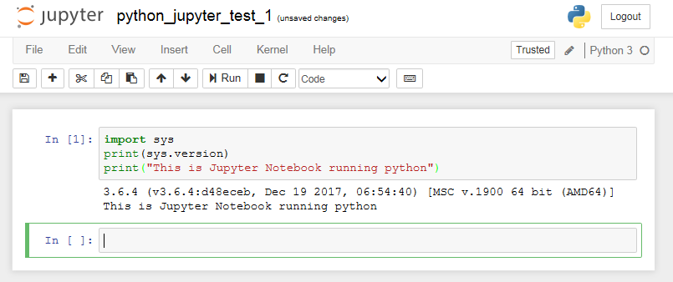
Jupyter Notebook
The code executes and output is displayed…
…after execution a new cell is created

Slide 18
Desktop
Notepad++
Main code
Jupyter
code snippets
Cmd window
Run program

Slide 19
Jupyter Notebook
Linux install on Ubuntu/Mate.

Slide 20
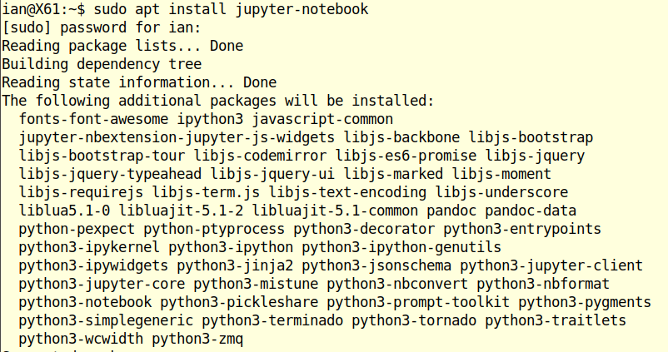
Jupyter Notebook
Linux install on Ubuntu/Mate.

Slide 21
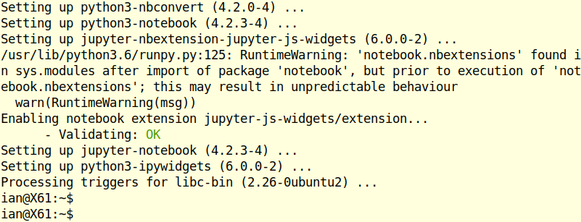
Jupyter Notebook
Linux install continued

Slide 22
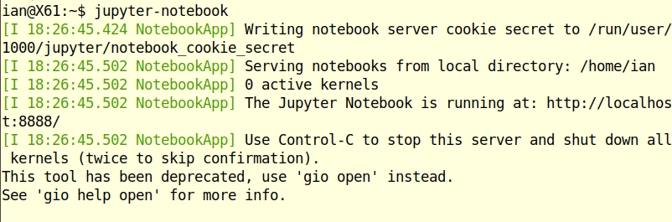
Jupyter Notebook
Launching jupyter-notebook

Slide 23
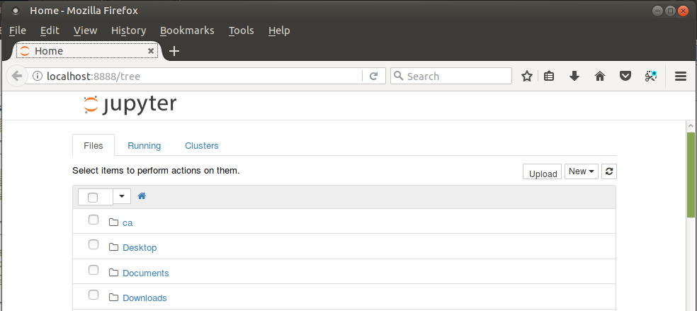
Jupyter Notebook
Browser window

Slide 24
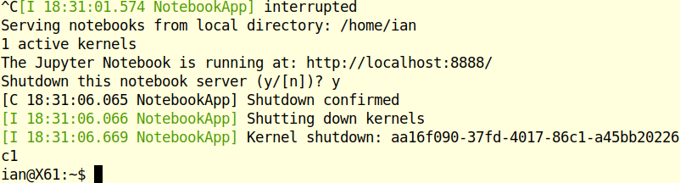
Jupyter Notebook
Stopping server

Slide 25
Jupyter Notebook
End of Jupyter Notebook installation.

